Slide 1
Lecture 13 Sparse Matrix-Vector Multiplication and CUDA Libraries
Kyu Ho Park
May 16, 2017
Ref:
1.David Kirk and Wen-mei Hwu, Programming Massively Parallel Processors, MK and NVIDIA.
2. Massimiliano Fatica, CUDA Libraries and CUDA FORTRAN, NVIDIA

Slide 2
Sparse Matrix
Sparse Matrix:
the majority of elements are zero.
These zero elements are waste of memory, time and energy.
Solution
Some type of compaction techniques with the cost of irregularity into the data representation.
The irregularity can lead to underutilization of memory bandwidth, control flow divergence, and load imbalance.

Slide 3
Sparse Matrix
Sparse matrix: a matrix where the majority of the elements are zero.
Example:
1 0 2 0
0 0 0 0
0 3 4 5
6 0 0 7
row 0
row 1
row 2
row 3
How to represent a sparse matrix?

Slide 4
Compressed Sparse Row(CSR) storage format
It consists of arrays data[], col_index[],and row_ptr[].
data[]: It stores all the non-zero values in the sparse matrix.
col_index[]: It represents the column index of every non- zero value in the sparse matrix.
row_ptr[]: It represents the beginning locations of each row.

Slide 5
CSR
row 0
row2
row3
data[]
1 | 2 | 3 | 4 | 5 | 6 | 7
0 | 2 | 1 | 2 | 3 | 0 | 3
col_index[]
row0
row1
row2
row3
row4
row_ptr[]
0 | 2 | 2 | 5 | 7

Slide 6
Linear System
A linear system of N equations of N variables can be expressed in the form of
AX + Y = 0,
where A is an N x N matrix,
X is a vector of N variables,
and Y is a vector of N constant values.

Slide 7
AX + Y =0
The solutions:
1. Calculate directly X= A⁻¹ x (-Y).
2. Iterative method by conjugate gradient
method:
(1) Guessing a solution X and calculate AX+Y, and see if the result is close to a 0 vector.
(2)If not, modify the X using a gradient vector formula.
(3)The most time-consuming part of this iterative approach is in the evaluation of AX+Y, which is a sparse matrix- vector multiplication.

Slide 8
CSR
row 0
row2
row3
data[]
1 | 2 | 3 | 4 | 5 | 6 | 7
0 | 2 | 1 | 2 | 3 | 0 | 3
col_index[]
row0
row1
row2
row3
row4
row_ptr[]
0 | 2 | 2 | 5 | 7

Slide 9
SpMV(Sparse Matrix Vector Multiplication) [1]
A sequential loop that implements SpMV.
AX (A = n x n matrix, X = n vector)
1. for(int row=0;row<num_rows;row++){
2. float dp=0;
3. int r_start=row_ptr[row];
4. int r_end=row_ptr[row+1];
5. for(int i=r_start; i<r_end; i++){
6. dp +=data[i]*x[col_index[i]];
7. }
8. y[row]+=dp;
9. }
dp: dot product

Slide 10
Parallel SpMV in CUDA
1 0 2 0
0 0 0 0
0 3 4 5
6 0 0 7
Thread 0
Thread 1
Thread 2
Thread 3

Slide 11
Parallel SpMV in CUDA[1]
1. __global__ void SPMV(int num_rows, float *data, int *col_index,
int *row_ptr, float *x, float *y) {
2. int row=blockIdx.x*blockDim.x + threadIdx.x;
3. if(row < num_rows){
4. float dp=0;
5. int r_start=row_ptr[row];
6. int r_end=row_ptr[row+1];
7. for(int i=r_start; i<r_end; i++){
8. dp +=data[i]*x[col_index[i]];
9. }
10. y[row]+=dp;
11. }

Slide 12
CSR
row 0
row2
row3
data[]
1 | 2 | 3 | 4 | 5 | 6 | 7
0 | 2 | 1 | 2 | 3 | 0 | 3
col_index[]
row0
row1
row2
row3
row4
row_ptr[]
0 | 2 | 2 | 5 | 7

Slide 13
Parallel SpMV/CSR
Simple
Memory access ?
does not make coalesced memory access.
Cause adjacent threads will be making simultaneous nonadjacent memory accesses.
Control Divergence Problem in all warps.
The number of iterations performed by a thread in the dot product loop depends on the number of nonzero elements in the row assigned to the thread. Since the distribution of nonzero elements among rows can be random, adjacent rows can have varying numbers of nonzero elements.

Slide 14
Parallel SpMV in CUDA
1 0 2 0
0 0 0 0
0 3 4 5
6 0 0 7
Thread 0
Thread 1
Thread 2
Thread 3

Slide 15
Padding and Transposition
1 | 2 | *
* | * | *
3 | 4 | 5
6 | 7 | *
1 | * | 3 | 6
2 | * | 4 | 7
* | * | 5 | *

Slide 16
ELL storage format (Padding and Transposition)
CSR representation:
Row0 data: 1 2 col_idx 0 2 row_ptr =[0,2,2,5,7]
Row2 data: 3 4 5 col_idx 1 2 3
Row3 data: 6 7 col_idx 0 3
CSR with padding
row0: 1 2 * 0 2 *
row1: * * * * * *
row2: 3 4 5 1 2 3
row3: 6 7 * 0 3 *

Slide 17
ELL Storage Format
row0: 1 2 * 0 2 *
row1: * * * * * *
row2: 3 4 5 1 2 3
row3: 6 7 * 0 3 *
1 * 3 6
2 * 4 7
* * 5 *
Row-major
Column-major

Slide 18
ELL format[1]
data[]:
index[]:
1 | * | 3 | 6 | 2 | * | 4 | 7 | * | * | 5 | *
0 | * | 1 | 0 | 2 | * | 2 | 3 | * | * | 3 | *
__global__ void SPMV_ELL(int num_rows, float *data, int *col_index,
int num_elel, float *x, float *y){
2. int row=blockIdx.x*blockDim.x + threadIdx.x;
3. if(row < num_rows) {
float dop=0;
for( int i=0; i<num_elem; i++){
dop+=data[row+i*num_rows]*x[col_index[row+i*num*rows]];
}
y[row]=dop;
}
}

Slide 19
SpMV/ELL
Regular form
No control divergence
Coalesced Memory Access
- By eliminating control flow divergence and enabling memory coalescing, SpMV/ELL should run faster than SpMV/CSR.
Draw back:
- In situations where one or a small number of rows have an exceedingly large number of nonzero elements, the ELL format will result in excessive number of padded elements. These padded elements will require storage space, need to be fetched, and perform calculations despite their lack of influence on the final result.

Slide 20
Hybrid method to Control Padding
Excessive padding in ELL is caused by one or small number of rows have an exceedingly large number of non-zero elements.
COO(coordinated) format:
It provides a mechanism to take away some elements from these rows.

Slide 21
COO format
row 1
row 2
row3
data[]
1 | 2 | 3 | 4 | 5 | 6 | 7
0 | 2 | 1 | 2 | 3 | 0 | 3
col_index[]
row_index[]
0 | 0 | 2 | 2 | 2 | 3 | 3

Slide 22
ELL + COO Hybrid Format
row0: 1 2 * 0 2 *
row1: * * * * * *
row2: 3 4 5 1 2 3
row3: 6 7 * 0 3 *
row0: 1 2 0 2
row1: * * * *
row2: 3 4 1 2
row3: 6 7 0 3
ELL Format:
1 | * | 3 | 6 | 2 | * | 4 | 7
0 | * | 1 | 0 | 2 | * | 2 | 3
+
data : 5
col_index : 3
row_index : 2
COO Format:

Slide 23
JDS(Jagged Diagonal Storage) format
COO helps to regulate the amount of padding in an ELL representation, we can further reduce the padding over head by sorting and partitioning the rows of a sparse matrix.
Sort the rows according to their length from the longest to the shortest.
Once a sparse matrix is in the JDS format, we can partition the matrix into sections of rows. Since the rows have been sorted, all rows in a section will likely have similar numbers of nonzero elements.
We can then generate an ELL representation for each section. Within each section, we only need to pad the rows to match the row with the maximal number of elements in that section. This method would reduce the number of padded elements.

Slide 24
Sorting and Partitioning for Regularization JDS(Jagged Diagonal Storage) format

Slide 25
Sorting and Partitioning for Regularization JDS(Jagged Diagonal Storage) format
row0: 1 2 0
row1: 0 0 0
row2: 3 4 5
row3: 6 7 0
3 4 5
1 2 0
6 7 0
0 0 0
CSR
JDS
Nonzero values data[7] {3,4,5,1,2,6,7}
Column indices col_index[7] {1,2,3,0,2,0,3}
JDS row indices jds_row_index[4] {2,0,3,1}
jds_section_pointer[4] {0,3,7,7]

Slide 26
CUDA Libraries[2]
Applications
Third Party Libraries
-CUFFT
-CUBLAS
-CUSPARSE
-Libm
-NPP
Thrust
NVIDIA Libraries
CUDA C Runtime

Slide 27
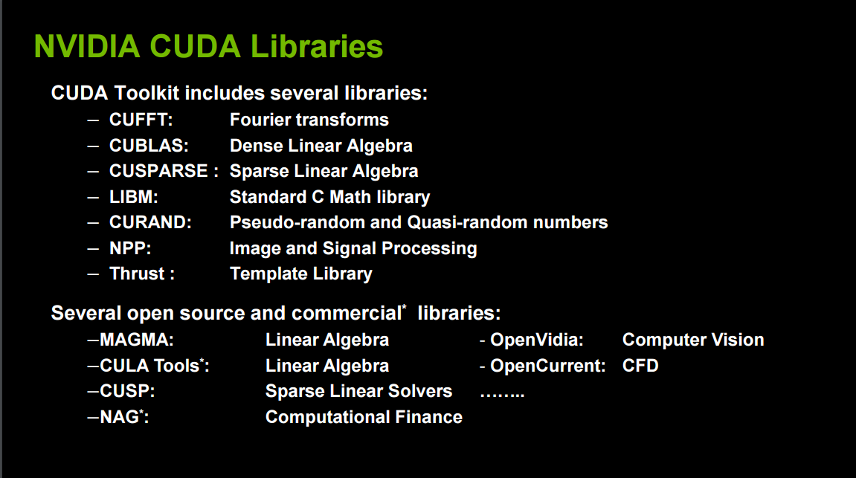
CUDA Libraries[2]

Slide 28
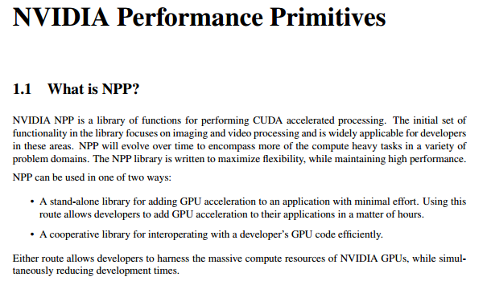
NPP

Slide 29
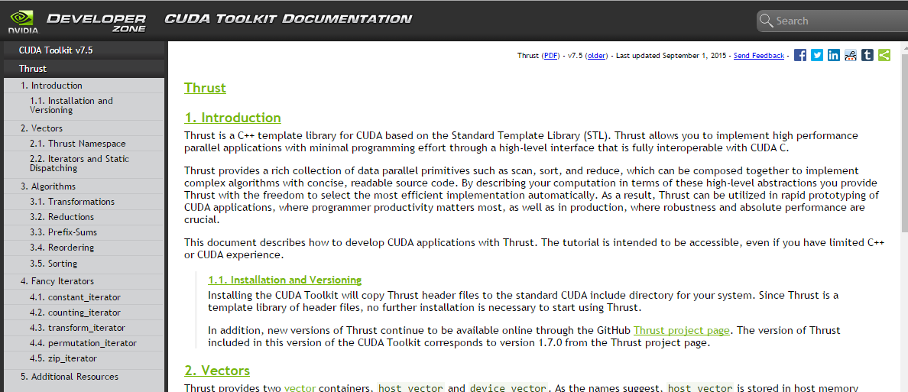
Thrust

Slide 30
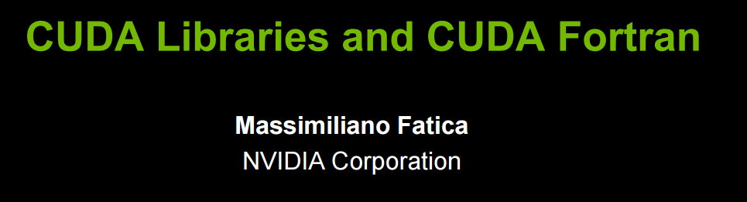
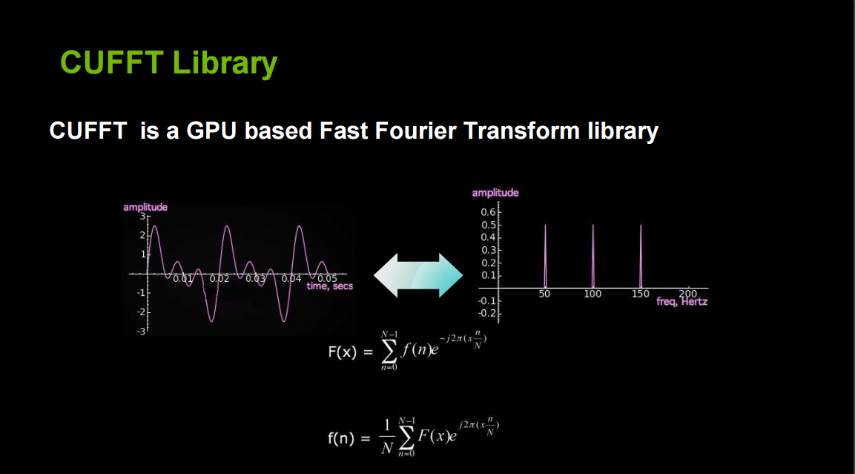

Slide 31
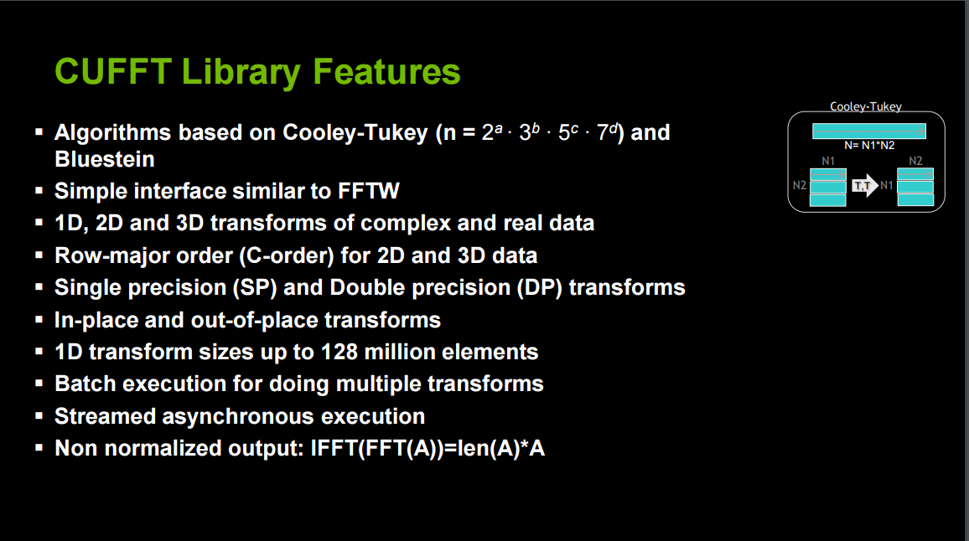
CUFFT[2]

Slide 32
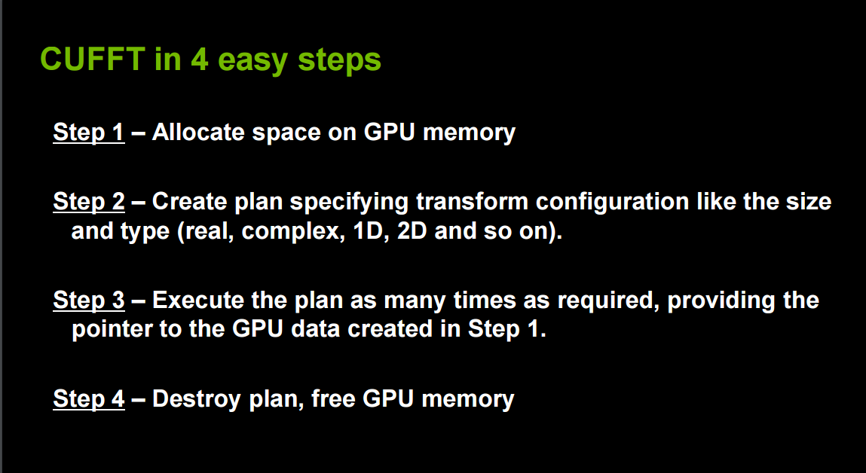
CUFFT[2]

Slide 33
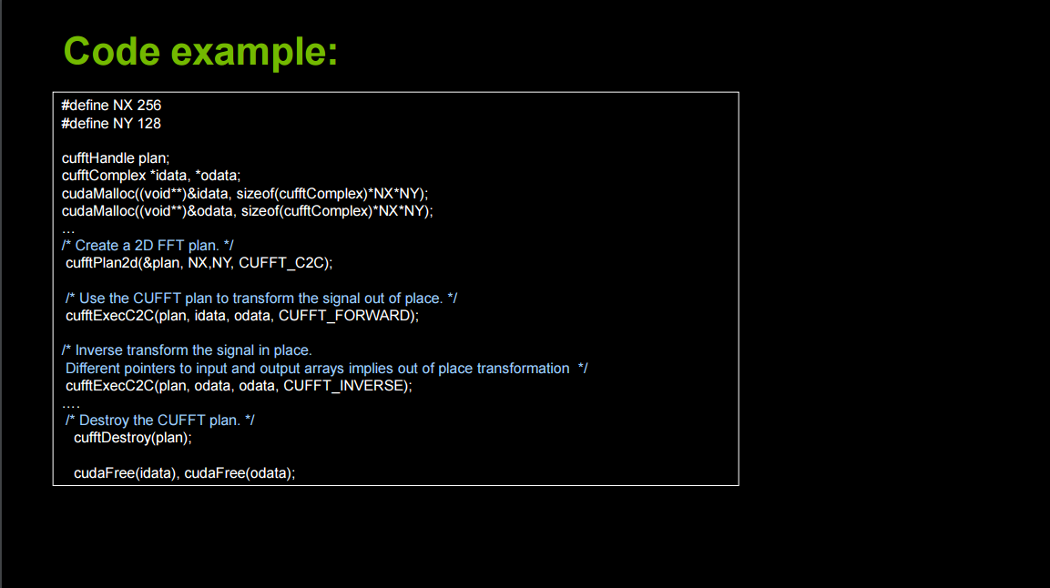
CUFFT

Slide 34
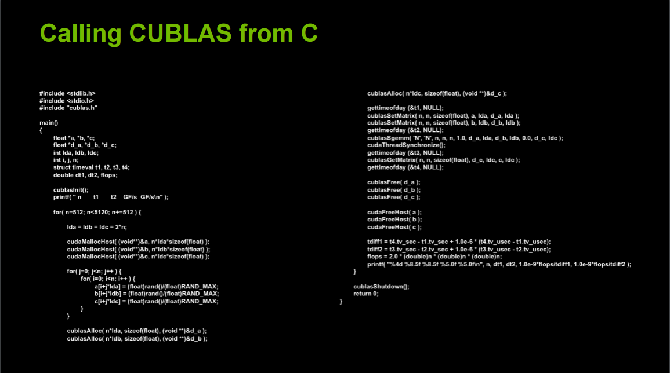
CUBLAS

Slide 35
CUSPARSE Library
Four types of operations:
Level 1: operations between a vector in sparse format and a vector in dense format. Functions: axpyi( y=y+ax), doti( z=y^{T} x)… etc.
Level 2: operations between a matrix in sparse format and a vector in dense format. Functions: mv( solve y=aAx+by), sv(solves a sparse triangular linear system).
Level 3: operations between a matrix in a sparse format and a vector in dense format. Functions: mm(C=aAB+bC), sm( solve a sparse triangular linear system.

Slide 36
CUSPARSE
The CURSPARSE functions are operated on the device.
Operations format:
cusparse< T > [<matrix data format>]operation[<output matrix format>]
,where
T={S,D,C,Z,X}//S:float, D:double,C:cuComplex,
Z:cuDoubleComplex, X: a generix type,
matrix data format:{dense,COO,CSR,CSC, HSB…….},
operation:{axpyi,doti,dotci,gthr,gthrz,roti,sctr}(level1),
{mv, sv}(level2),and {mm,sm }(level3).

Slide 37
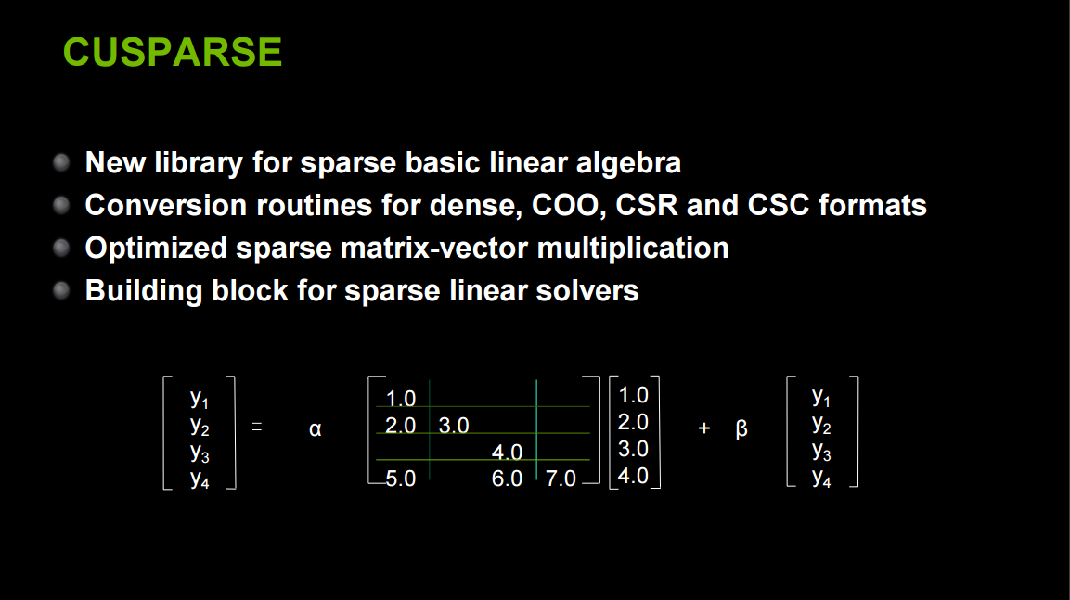
CUSPARSE[2]

Slide 38
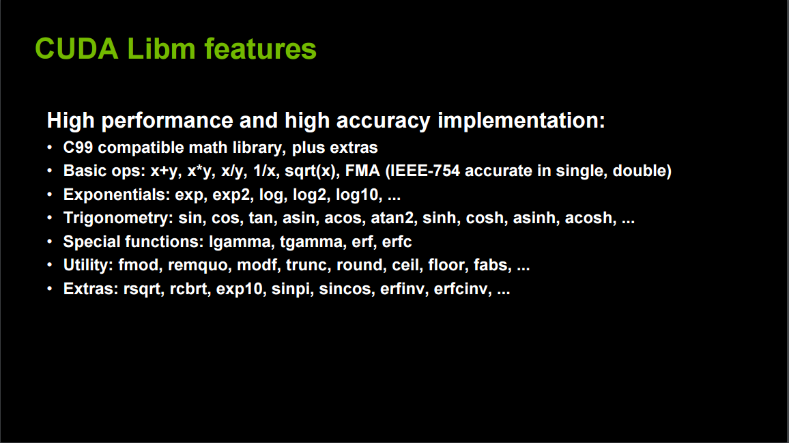
Libm[2]

Slide 39
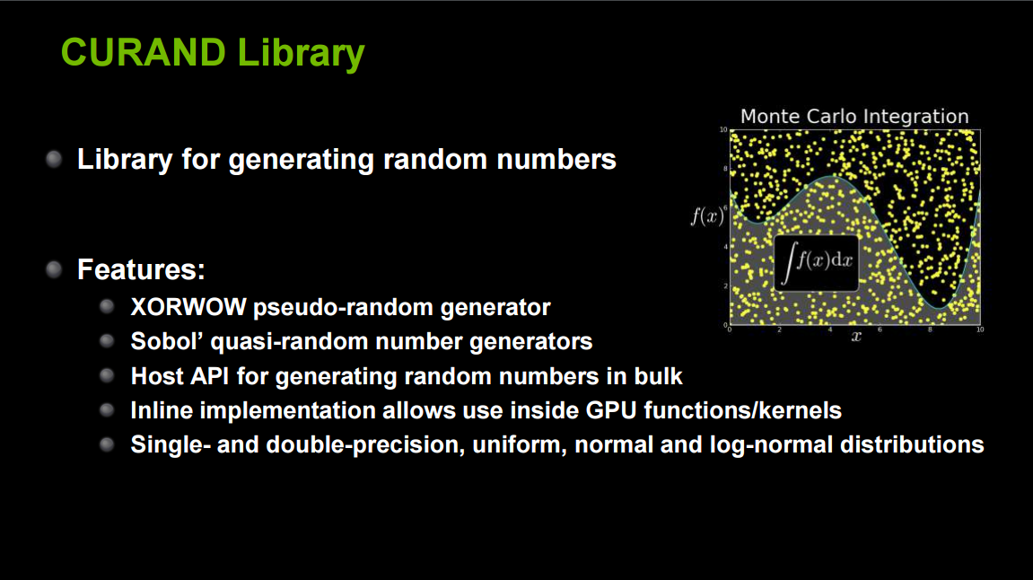
CURAND

Slide 40
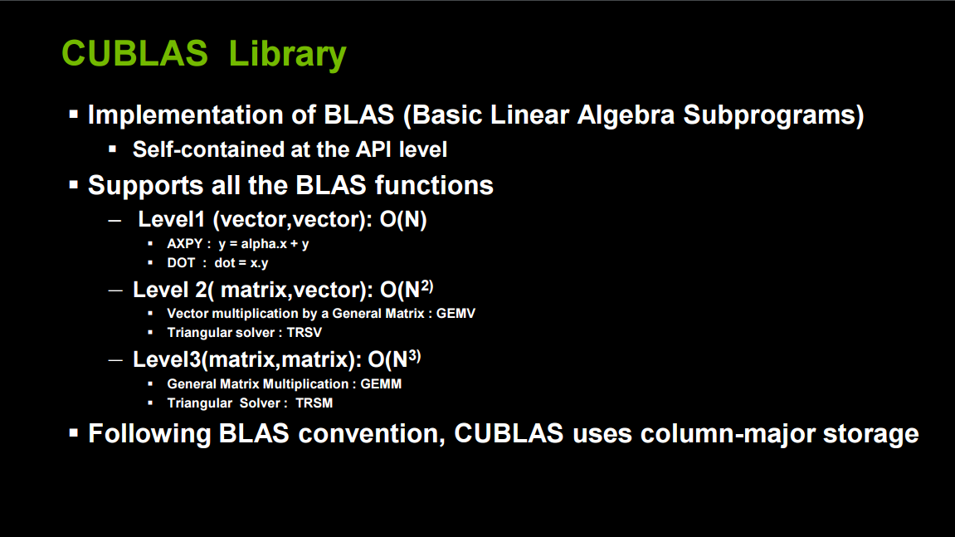
CUBLAS[2]

Slide 41
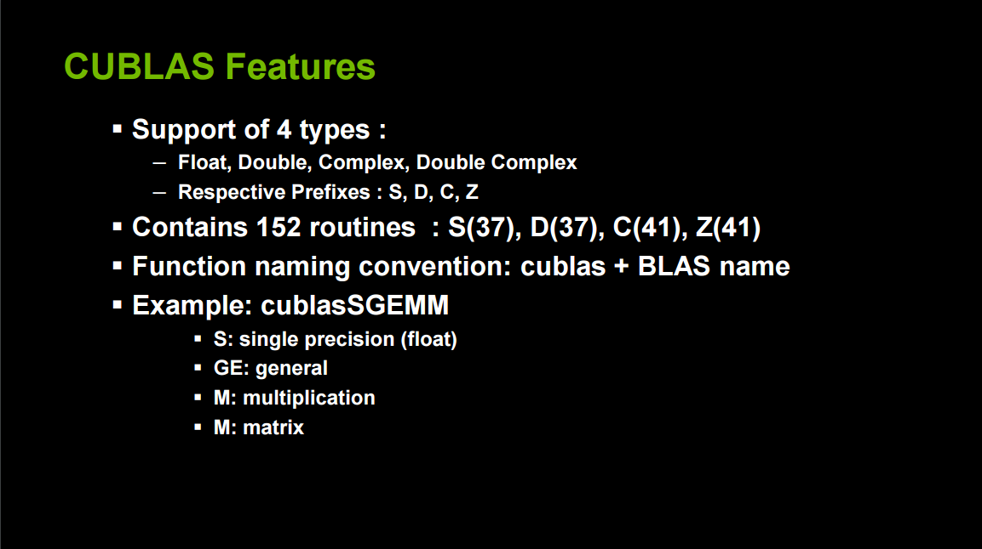
CUBLAS[2]

Slide 42
Homework#5 Sparse Matrix
Use the random matrix generation program cusparse.cu of Chap. 8 to generate two random matrices A and B, and perform matrix-matrix multiplication using cuSPARSE.
The size of each sparse matrix is 1024x1024.
You may refer to the solution program ‘cusparse-matrix-
matrix.cu’.
Problem 1. Use the storage format COO.
Problem 2. Use the storage format CSC.
Problem 3. Use the storage format ELL.
Problem 4. Use the storage format HYB.
(Use the same matrices A and B for all problems)

Slide 43
Homework #5
Evaluate and compare the performance of each result with the naïve matrix multiplication of your program of Homework#3 applied to these sparse matrix A and B.
Due: May 30,2017
Submit your report to
Kim Woo Joong, PhD Student(w.j.kim@kaist.ac.kr)

Slide 44
Presentation Schedule on May 25
17. Fast Fourier Transform and CUFFT Lib: 유찬희
18. Multi-GPU Programming: 이준희
19. CUDA Debugging: 김재엽
20. PyCUDA : 김진권

